Slide 1
动画
hover效果，loading效果，点击效果

Slide 2
hover效果

Slide 3

Caption Hover Effects
http://tympanus.net/codrops/2013/06/18/caption-hover-effects/

Slide 4
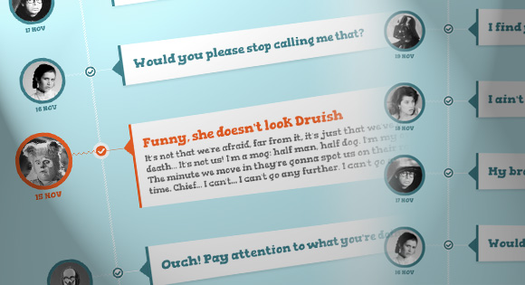
Responsive CSS Timeline with 3D Effect
http://tympanus.net/codrops/2012/11/19/responsive-css-timeline-with-3d-effect/

Slide 5

3D Thumbnail Hover Effects
http://tympanus.net/codrops/2012/06/18/3d-thumbnail-hover-effects/

Slide 6

Thumbnail Proximity Effect with jQuery and CSS3
http://tympanus.net/codrops/2012/01/04/thumbnail-proximity-effect/

Slide 7

Animated Opening Type
http://tympanus.net/codrops/2013/11/14/animated-opening-type/

Slide 8

Hover and Click Trigger for Circular Elements with jQuery
http://tympanus.net/codrops/2011/11/22/hover-and-click-trigger-circular-elements/

Slide 9
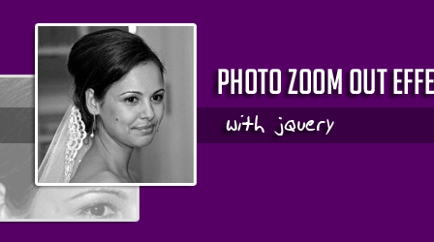
Photo Zoom Out Effect with jQuery
http://tympanus.net/codrops/2010/03/07/photo-zoom-out-effect-with-jquery/

Slide 10
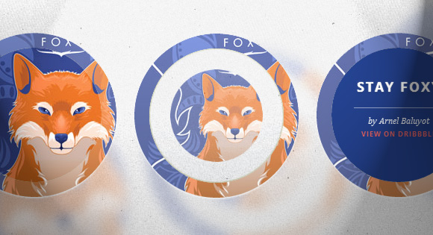
Circle Hover Effects with CSS Transitions
http://tympanus.net/codrops/2012/08/08/circle-hover-effects-with-css-transitions/

Slide 11
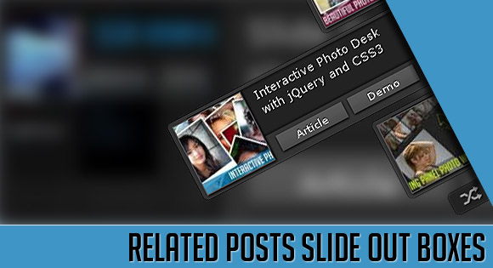
Related Posts Slide Out Boxes with jQuery and CSS3
http://tympanus.net/codrops/2010/07/21/related-posts-slide-out-boxes/

Slide 12

Creative CSS3 Animation Menus
http://tympanus.net/codrops/2011/10/24/creative-css3-animation-menus/

Slide 13

Original Hover Effects with CSS3
http://tympanus.net/codrops/2011/11/02/original-hover-effects-with-css3/

Slide 14
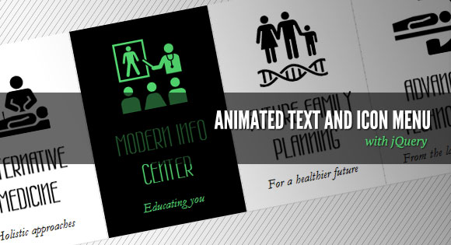
Animated Text and Icon Menu with jQuery
http://tympanus.net/codrops/2011/07/12/animated-text-and-icon-menu/

Slide 15
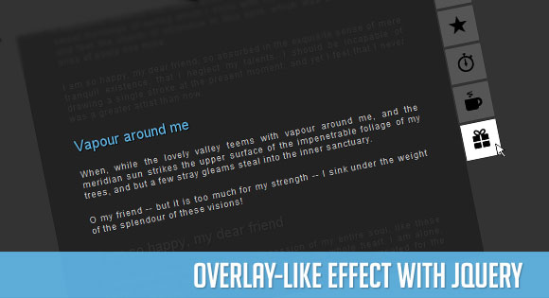
Overlay-like Effect with jQuery
http://tympanus.net/codrops/2011/02/15/overlay-like-effect/

Slide 16
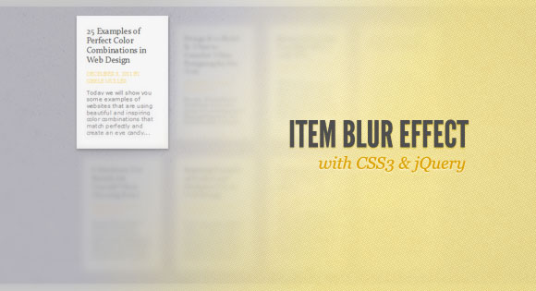
Item Blur Effect with CSS3 and jQuery
http://tympanus.net/codrops/2011/12/14/item-blur-effect-with-css3-and-jquery/

Slide 17
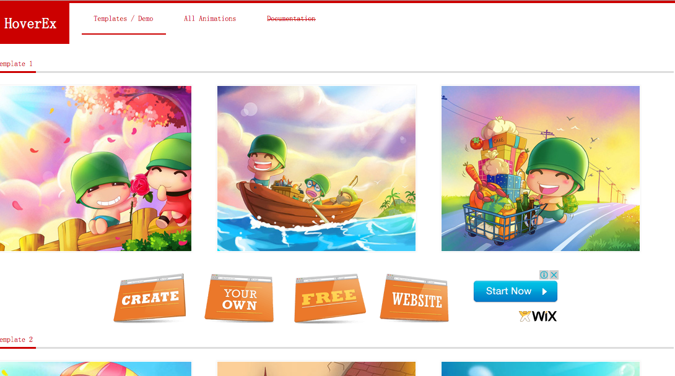
HoverEx
http://js.itivy.com/jiaoben1043/index.html

Slide 18
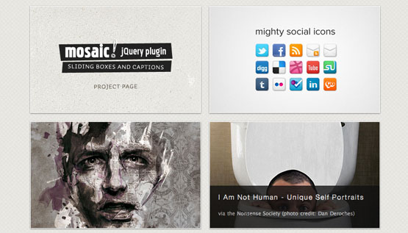
mosaic
http://buildinternet.com/project/mosaic/

Slide 19
loading效果

Slide 20
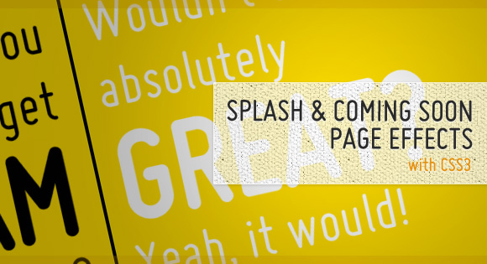
Splash and Coming Soon Page Effects with CSS3
http://tympanus.net/codrops/2011/12/07/splash-and-coming-soon-page-effects-with-css3/

Slide 21

Interactive Infographic with SVG and CSS Animations
http://tympanus.net/codrops/2013/02/06/interactive-infographic-with-svg-and-css-animations/

Slide 22

Custom Animation Banner with jQuery
http://tympanus.net/codrops/2010/10/18/custom-animation-banner/

Slide 23
ICON
Ajax Loading Gif, FavIcon

Slide 24
FAVICON
FavIcon from Pics (http://www.chami.com/html-kit/services/favicon/)
favico.js (http://lab.ejci.net/favico.js/)
Favicon (http://www.favicon.cc/)

Slide 25
Ajax Loading Gif
Ajaxload (http://ajaxload.info/)
Preloaders (http://preloaders.net/)
Load Info (http://www.loadinfo.net/)
AJAX Activity indicators (http://mentalized.net/activity-indicators/)
Sonic (http://james.padolsey.com/p/Sonic/repo/demo/demo.html)
Cssload (http://cssload.net/)

Slide 26
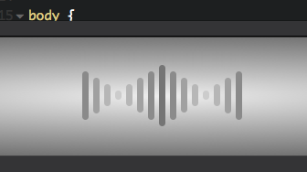
CSS3 Loading Animation
http://codepen.io/MyXoToD/pen/Djnbq

Slide 27



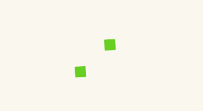
CSS3 Loading Animation
http://www.cnblogs.com/lhb25/p/loading-spinners-animated-with-css3.html

Slide 28

spinkit
http://tobiasahlin.com/spinkit/

Slide 29

CSS3 Loading Animation Loop
http://www.alessioatzeni.com/blog/css3-loading-animation-loop/

Slide 30
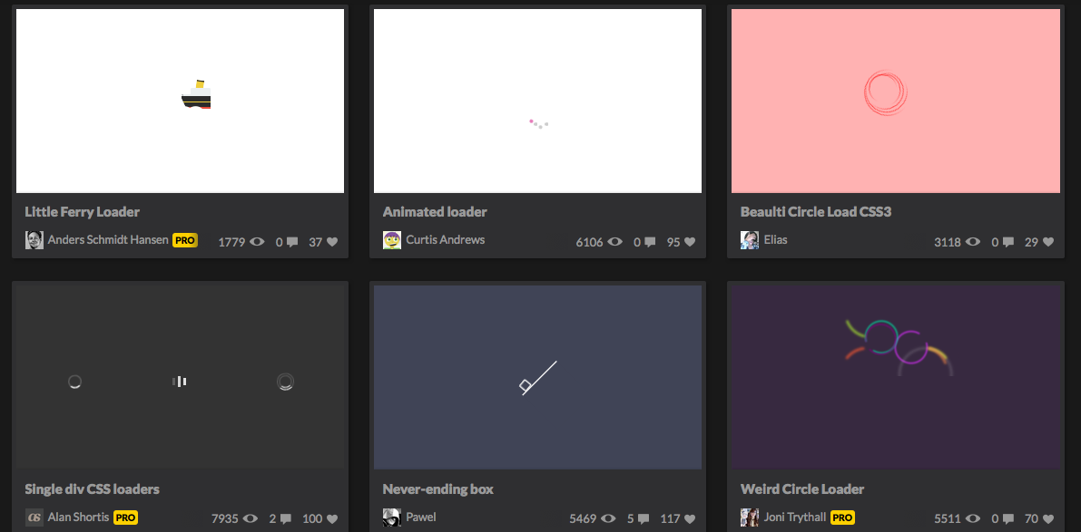
Loaders and Spinners
http://codepen.io/collection/HtAne/#

Slide 31

Creative CSS Loading Animations
http://tympanus.net/codrops/2012/11/14/creative-css-loading-animations/

Slide 32

Flat Style Squared Preloaders
http://tympanus.net/codrops/2014/04/25/freebie-flat-style-squared-preloaders

Slide 33
展开效果

Slide 34
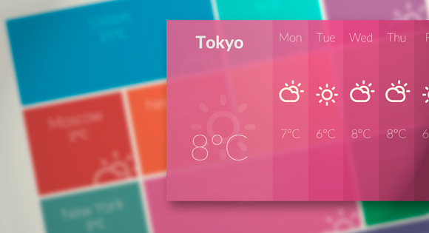
Expanding Overlay Effect
http://tympanus.net/codrops/2013/01/17/putting-css-clip-to-work-expanding-overlay-effect/

Slide 35
3D效果

Slide 36
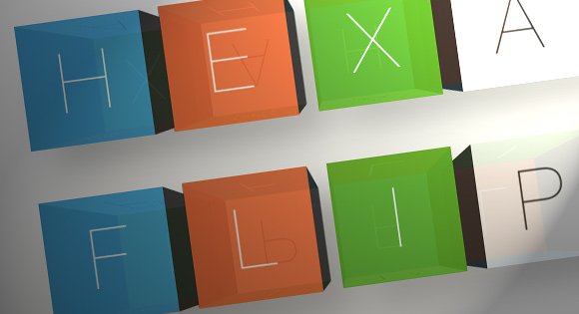
HexaFlip
http://tympanus.net/codrops/2013/03/07/hexaflip-a-flexible-3d-cube-plugin/

Slide 37

3D Shading with Box-Shadows
http://tympanus.net/codrops/2013/08/27/3d-shading-with-box-shadows/

Slide 38
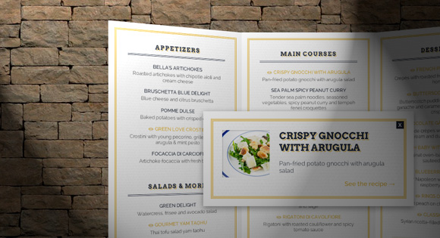
3D Restaurant Menu Concept
http://tympanus.net/codrops/2012/09/25/3d-restaurant-menu-concept/

Slide 39
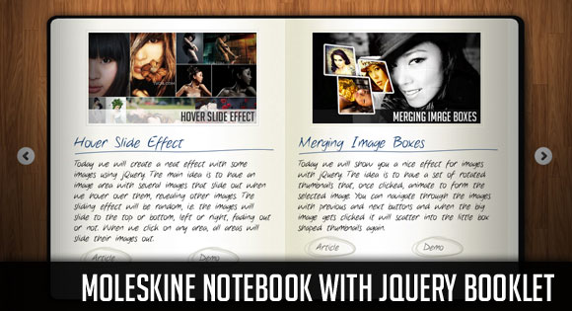
Moleskine Notebook with jQuery Booklet
http://tympanus.net/codrops/2010/12/14/moleskine-notebook/

Slide 40
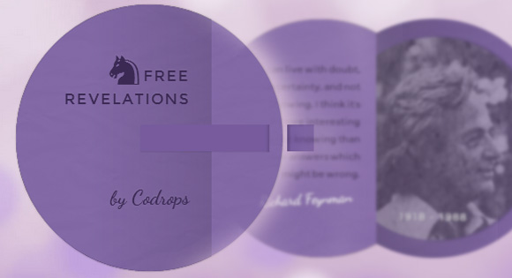
3D Flipping Circle with CSS3 and jQuery
http://tympanus.net/codrops/2012/07/20/3d-flipping-circle-with-css3-and-jquery/

Slide 41
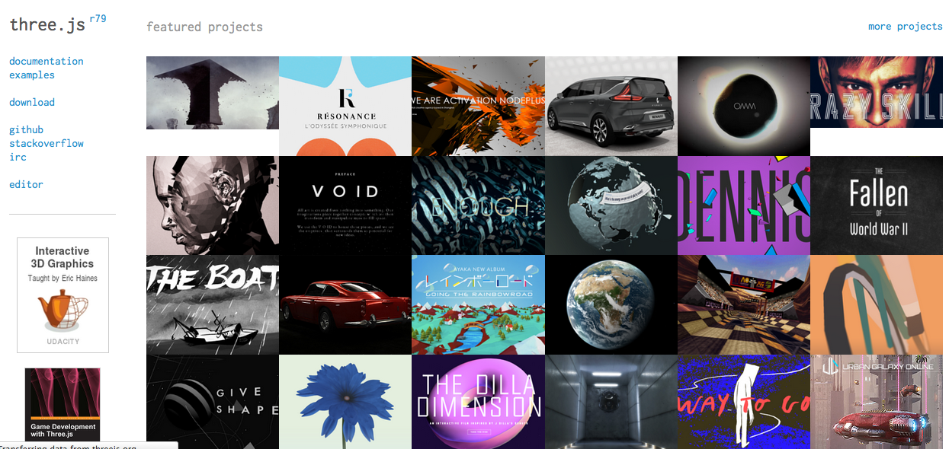
Three.js
http://threejs.org/

Slide 42
点击效果

Slide 43
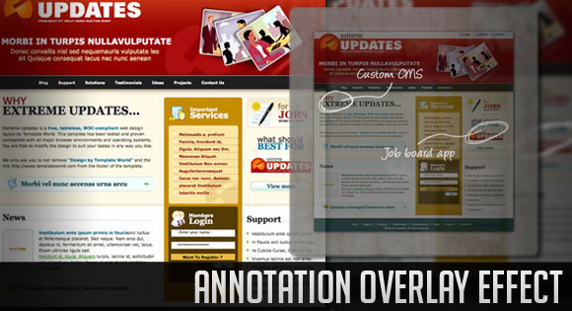
Annotation Overlay Effect with jQuery
http://tympanus.net/codrops/2010/10/12/annotation-overlay-effect/

Slide 44
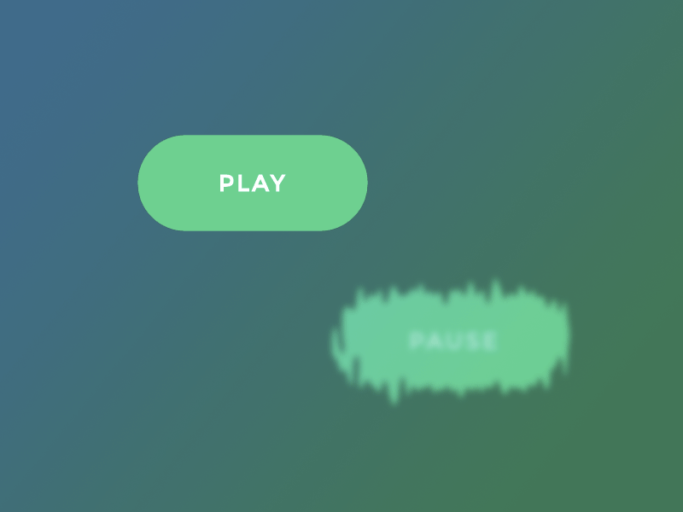
Distorted Button Effects with SVG Filters
http://tympanus.net/codrops/2016/05/11/distorted-button-effects-with-svg-filters/

Slide 45
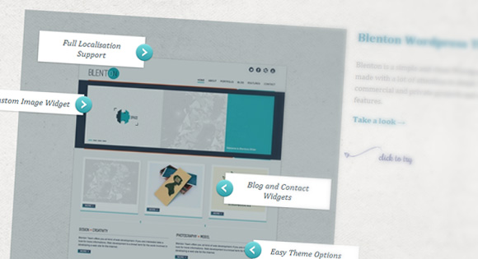
Annotation Overlay Effect with CSS3
http://tympanus.net/codrops/2012/05/14/annotation-overlay-effect-with-css3/

Slide 46
Annotation Overlay Effect with jQuery
http://tympanus.net/codrops/2010/10/12/annotation-overlay-effect/

Slide 47
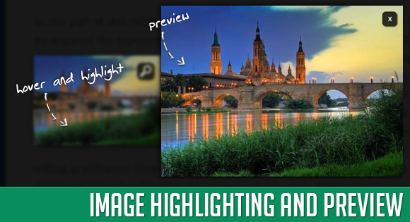
Image Highlighting and Preview with jQuery
http://tympanus.net/codrops/2010/07/04/image-highlighting-preview/

Slide 48
动画
SVG，动画开发工具,动画JS库

Slide 49
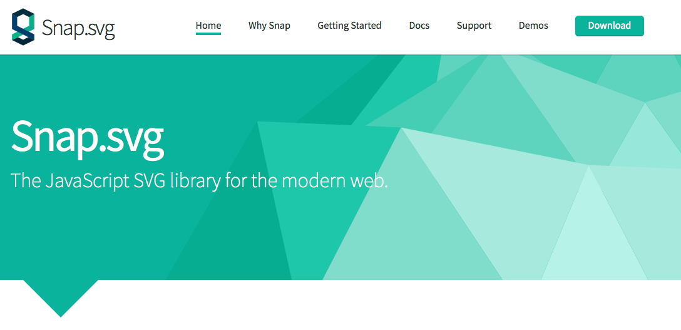
SVG
Snapsvg (http://snapsvg.io/)
svg.js （http://svgjs.com/）

Slide 50
动画开发工具
Edge Animate
Sencha Animator

Slide 51
动画JS库
TweenJS
http://www.createjs.com/tweenjs
CSS3 Animation Cheat Sheet
http://www.justinaguilar.com/animations/index.html
Paper.js
http://paperjs.org/
Animatable
http://leaverou.github.io/animatable/

Slide 52
动画JS库
ball-pool
http://mrdoob.com/projects/chromeexperiments/ball-pool/
move.js
https://github.com/visionmedia/move.js
textillate
https://github.com/jschr/textillate
rekapi
https://github.com/jeremyckahn/rekapi/

Slide 53
动画JS库
Transit
http://ricostacruz.com/jquery.transit/
Motio
http://darsa.in/motio/
stroll.js
https://github.com/hakimel/stroll.js

Slide 54
动画暂停——Pause http://tobia.github.io/Pause/
jQuery 本身的动画只有停止的功能，一但停止(stop)后就无法自动接着做未做完的动画内容。 因此Pause插件扩充了animate() 的功能，让它可以支持暂停(pause)及恢复(resume)动画。
这个插件覆盖jQuery的默认的animate()方法，任何加载了这个插件的动画都将支持Pause暂停。两个新的不带任何参数的方法被添加到每一个jQuery对象：pause()和resume()。
例如：
$box.hover(function() {
$box.pause();
}, function() {
$box.resume();
});

Slide 55
动画效果

Slide 56
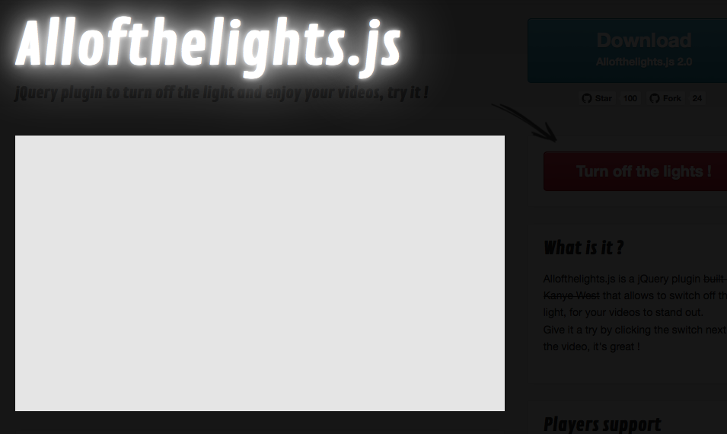
关灯效果——Allofthelights.js http://www.megaptery.com/allofthelights/

Slide 57
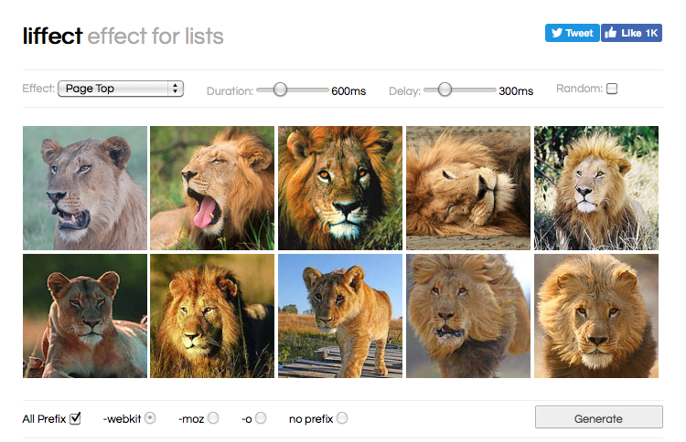
动画效果
rainyday.js ——雨滴效果
http://maroslaw.github.io/rainyday.js/
Liffect —— list特效
http://www.ademilter.com/lab/liffect/

Slide 58
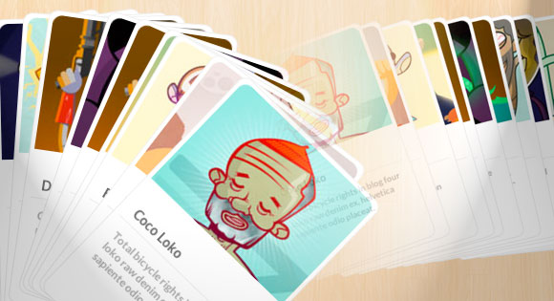
动画效果
Baraja (http://tympanus.net/codrops/2012/11/13/baraja-a-plugin-for-spreading-items-in-a-card-like-fashion/)

Slide 59
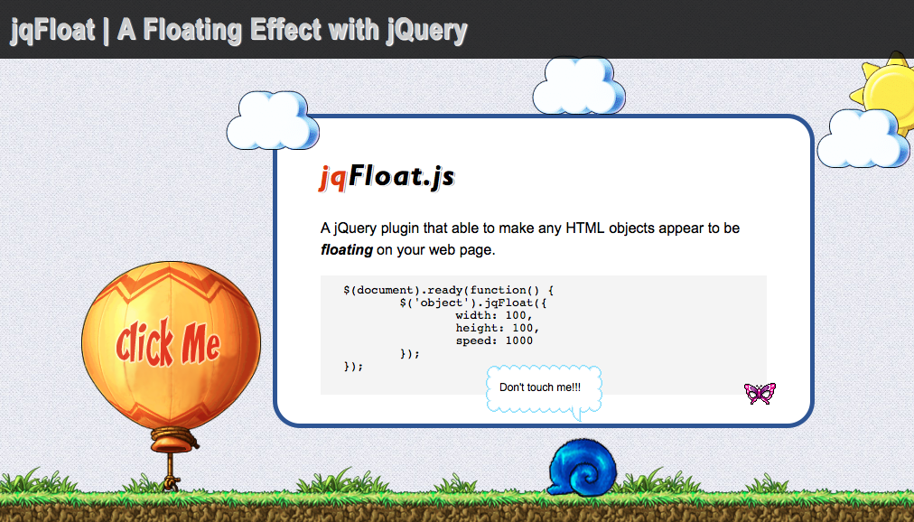
动画效果——漂浮效果
jqFloat.js
http://www.inwebson.com/jquery/jqfloat-js-a-floating-effect-with-jquery/

Slide 60
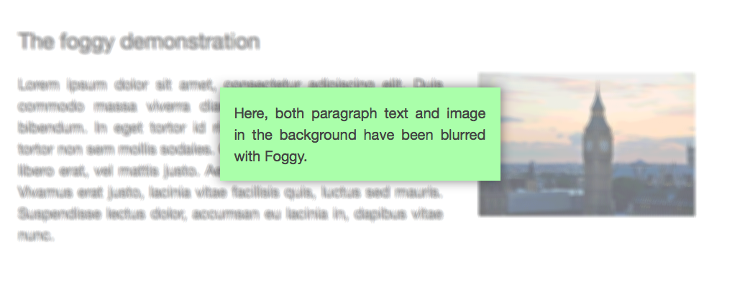
动画效果——雾化效果
Foggy
http://nbartlomiej.github.io/foggy/

Slide 61
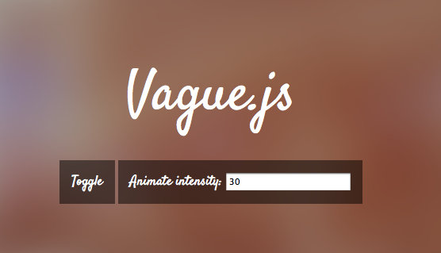
动画效果——模糊效果
blur.js
https://github.com/jakiestfu/Blur.js
Vague.js
http://gianlucaguarini.github.io/Vague.js/

Slide 62

动画效果——Admin系统
blur-admin
https://github.com/akveo/blur-admin

Slide 63

动画效果——翻页
Windy (http://tympanus.net/codrops/2012/10/09/windy-a-plugin-for-swift-content-navigation/)

Slide 64
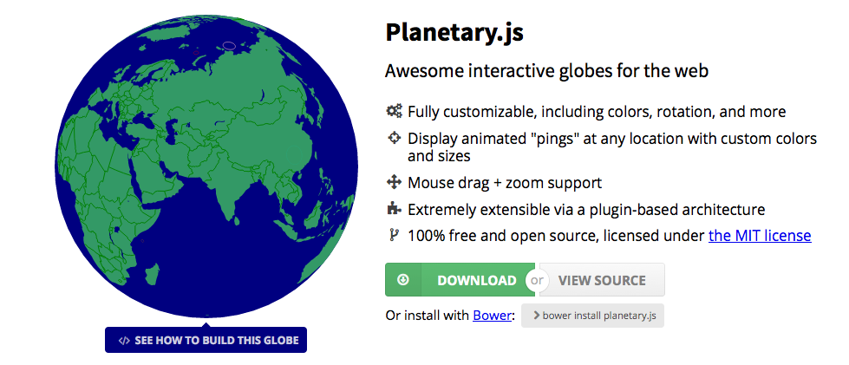
动画效果——地球仪
Planetary.js
http://planetaryjs.com/

Slide 65
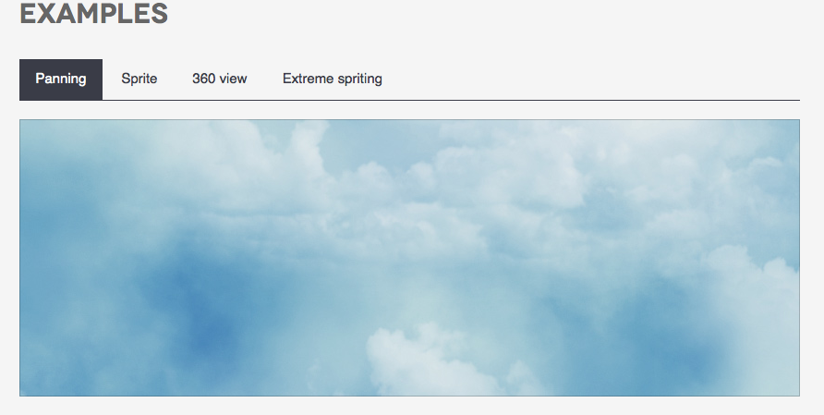
动画效果
Motio
http://darsa.in/motio/#game

Slide 66
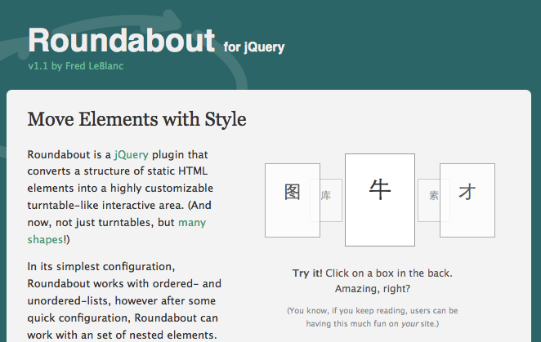
动画效果——列表回旋
Roundabout
https://github.com/fredleblanc/roundabout

Slide 67
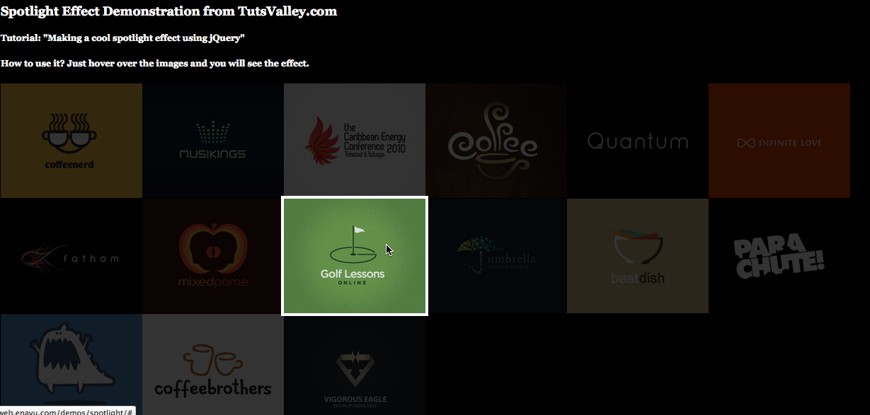
动画效果——聚光灯效果
Making a Cool Spotlight Effect with jQuery
http://web.enavu.com/tutorials/making-a-cool-spotlight-effect-with-jquery/

Slide 68
动画效果——重力感应
Gravity simulation in jQuery
http://blog.themeforest.net/tutorials/simulate-gravity-with-jquery/
jquery-gravity
http://www.tinybigideas.com/plugins/jquery-gravity/

Slide 69
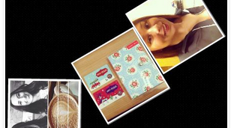
CSS3图片重力感应特效
http://js.itivy.com/?p=1186

Slide 70
动画效果——元素抖动
jRumble v1.3
https://github.com/jackrugile/jrumble/
csshake
http://elrumordelaluz.github.io/csshake/

Slide 71
翻书效果

Slide 72
翻书效果
turn.js（http://www.turnjs.com/#get）
BookBlock（http://tympanus.net/Development/BookBlock/index.html）
FlipboardPageLayout（http://tympanus.net/Development/FlipboardPageLayout/）
FullscreenBookBlock（http://tympanus.net/Tutorials/FullscreenBookBlock/）

Slide 73
翻书效果
jFlip（http://www.jquery.info/scripts/jFlip/demo.html）
WordPress Gallery Plugin（http://pageflipgallery.com/online-demo/）

Slide 74
折叠效果

Slide 75
折叠效果
OriDomi （http://oridomi.com/）
Pfold（http://tympanus.net/codrops/2012/10/17/pfold-paper-like-unfolding-effect/）
Makisu（https://github.com/soulwire/Makisu）

Slide 76

CSS3 Animated Clouds
http://codepen.io/anon/pen/bkpyv

Slide 77
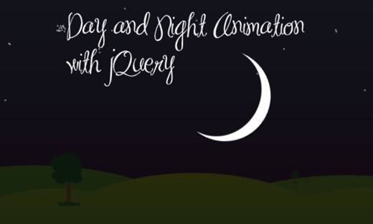
Day and Night
http://tympanus.net/codrops/2009/12/14/day-and-night-creating-animation-with-jquery-and-css/

Slide 78
动画缓动效果

Slide 79
动画缓动效果
Animate.css
http://daneden.github.io/animate.css/#cta
Easing
http://gsgd.co.uk/sandbox/jquery/easing/
Morf.js
http://www.joelambert.co.uk/morf/
magic_animations
http://minimamente.com/example/magic_animations/

Slide 80
动画缓动效果
Bounce.js
http://bouncejs.com/
Hover.css
http://ianlunn.github.io/Hover/
iHover
http://gudh.github.io/ihover/dist/index.html
AniJS
http://anijs.github.io/

Slide 81
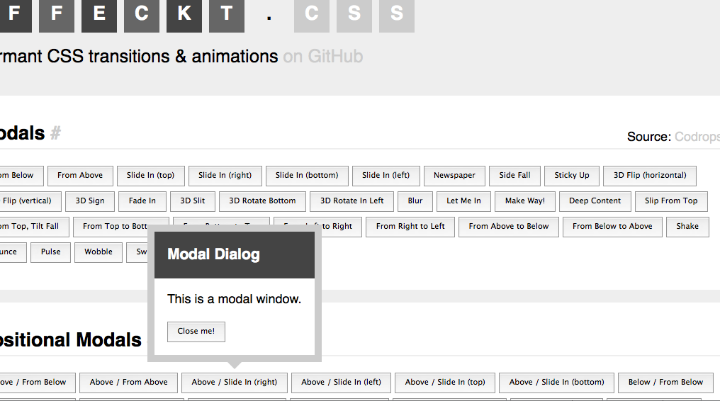
Effeckt.css
http://h5bp.github.io/Effeckt.css/

Slide 82
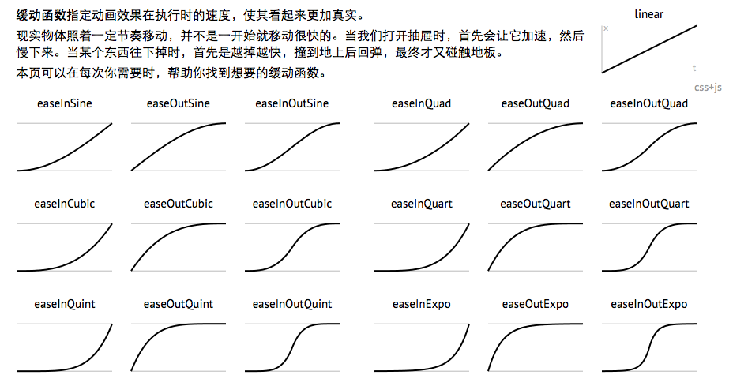
缓动函数速查表 http://easings.net/zh-cn

Slide 83
动态背景

Slide 84
动态背景
tubularhttp://www.seanmccambridge.com/tubular/
BigVideo.js
http://dfcb.github.io/BigVideo.js/
jquery-backstretch
https://github.com/srobbin/jquery-backstretch
jquery.videoBG
http://www.syddev.com/jquery.videoBG/

Slide 85
Page Transition
页面切换

Slide 86
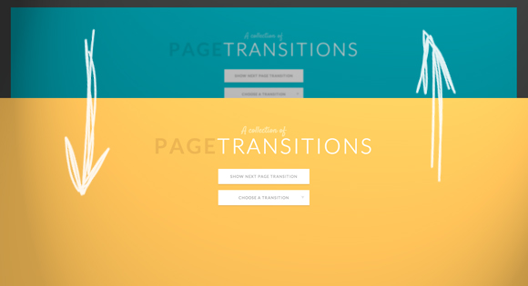
A Collection of Page Transitions
http://tympanus.net/codrops/2013/05/07/a-collection-of-page-transitions/

Slide 87
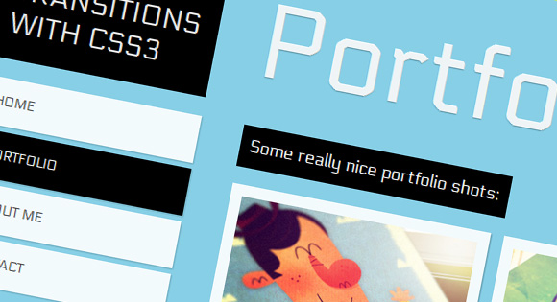
Page Transitions with CSS3
http://tympanus.net/codrops/2012/01/30/page-transitions-with-css3/

Slide 88
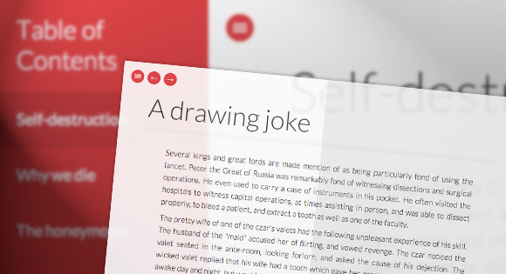
Fullscreen Pageflip Layout
http://tympanus.net/codrops/2012/12/11/fullscreen-pageflip-layout/

Slide 89
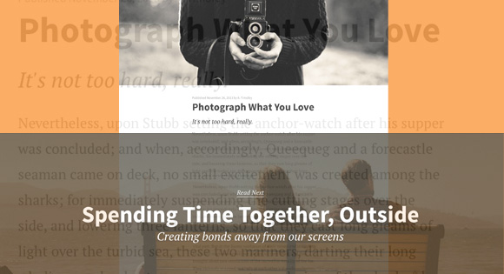
Medium-Style Page Transition
http://tympanus.net/codrops/2013/10/30/medium-style-page-transition/

